Slide 1
ANC Headset
Production Test Solution

Slide 2
CONTENS
01
Backgrounds
02
IQC
03
OQC
04
ANC Auto Calibration
05
Product Specification

Slide 3
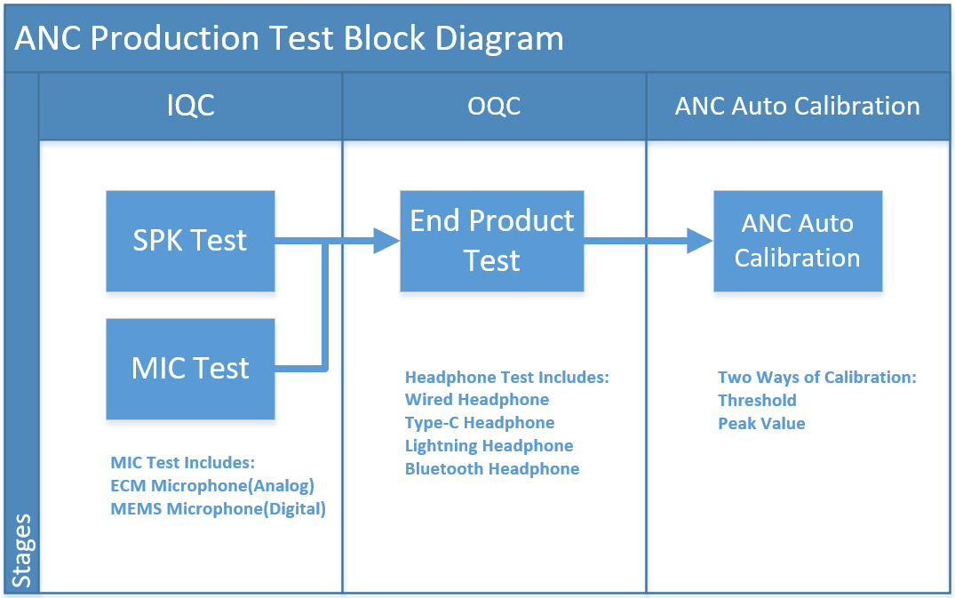
Backgrounds
Production test of ANC headset falls into three stages: IQC, OQC, and ANC auto calibration.
IQC tests acoustic performance of SPKs and ANC MICs. High consistency SPKs and ANC MICs improve the yield of ANC auto calibration, reducing the cost of retest.
OQC tests acoustic performance of headphone, such as Frequency Response and THD tests of SPKs and MICs. We have developed solutions for all kinds of headphone.
The ANC auto calibration automatically adjusts the ANC gain to achieve the best ANC performance.
CRY6151B electro-acoustic analyzer is the newest electro-acoustic analyzer developed by CRY Sound with powerful functions and high stability.
Measurement Devices: Microphone(ECM, MEMS), Headphone(wired, Bluetooth, Type-C, Lightning, ANC), Receiver, Micro Speaker, Loudspeaker(wired, Bluetooth)
Measurement parameters: Frequency Response, Sensitivity, Impedance, THD, Rub&Buzz, Resonant Frequency(F0), Balance, Position of Headphones, Phase Polarity, Current and Voltage of Microphone, Signal to Noise Ratio(SNR), Directivity, T&S Parameters, Loudness Rating and so on

Slide 4
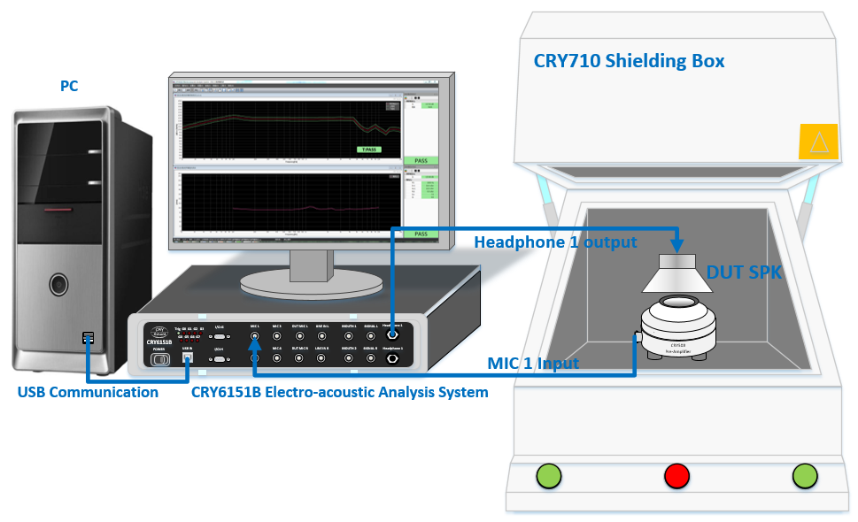
IQC
SPK Test
Typical Test Item
Frequency Response
Total Harmonic Distortion(THD)
Rub&Buzz
Impedance
Typical Test Range: 20Hz～20kHz
Equipment List
CRY6151B Electro-acoustic Analyzer
CRY318 Ear Simulator
CRY372 Measurement Microphone for Pressure Field
CRY508 ICP Preamplifier
CRY710 Shielding Box
Test Access
Connect DUT SPK to CRY6151B
CRY6151B outputs audio to DUT SPK -> Audio acquisition through measurement microphone ->Input into CRY6151B to analyze

Slide 5
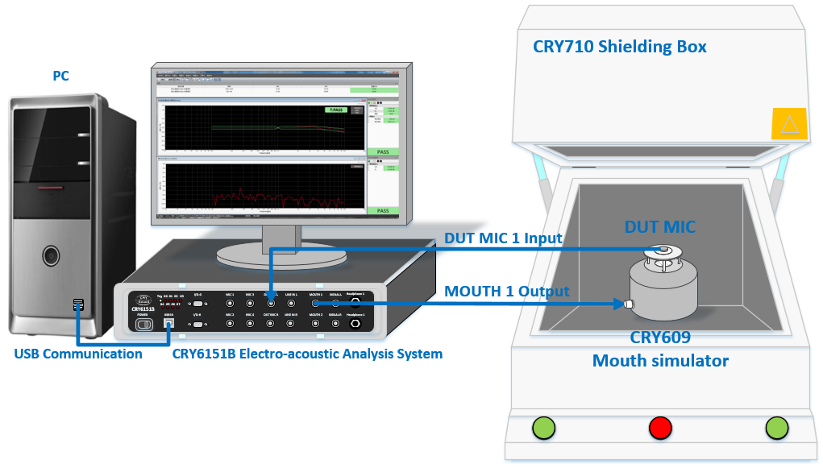
IQC
MIC Test
Typical Test Item
Frequency Response
Total Harmonic Distortion(THD)
Phase
Signal to Noise Ratio(SNR)
Typical Test Range: 100Hz-10kHz
Equipment List
CRY6151B Electro-acoustic Analyzer
CRY609 Mouth Simulator
CRY710 Shielding Box
Test Access
Connect DUT MIC to CRY6151B
CRY6151B outputs audio to CRY609 mouth simulator -> Audio acquisition through DUT MIC->Input into CRY6151B to analyze

Slide 6
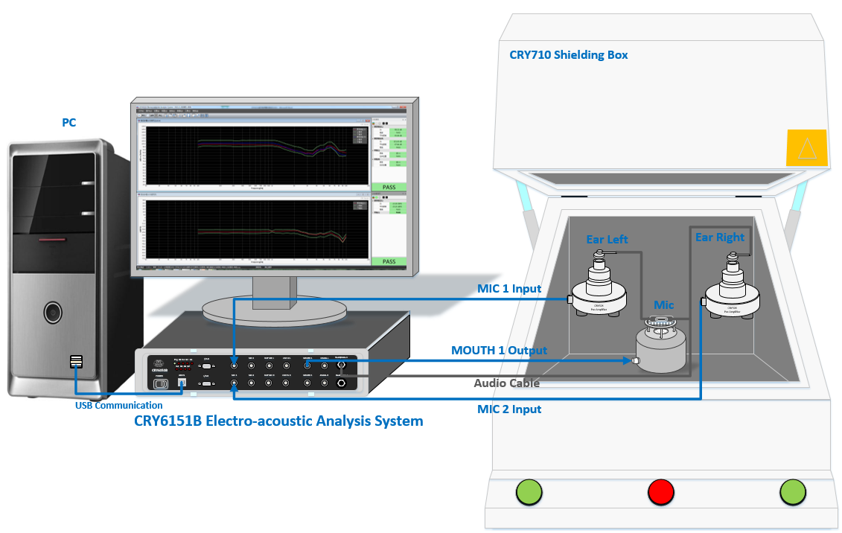
OQC
Wired Headphone Test
Headphone SPK Typical Test Item
Frequency Response
THD
Typical Test Range: 20Hz-20kHz
Rub&Buzz
Phase
Balance
Headphone MIC Typical Test Item
Frequency Response
Typical Test Range: 100Hz-10kHz
SNR
THD
Equipment List
CRY6151B Electro-acoustic Analyzer
CRY609 Mouth Simulator
CRY710 Shielding Box
Headphone
CRY801 Headset Fixture
CRY318 Ear Simulator
CRY372 Measurement Microphone for Pressure Field
CRY506 ICP Preamplifier
Earbud
CRY711 Ear Simulator
CRY508 ICP Preamplifier
Test Access
Connect headphone to CRY6151B headphone jack
CRY6151B outputs audio to headphone SPK ->Audio acquisition through measurement microphone -> Input into CRY6151B to analyze
CRY6151B outputs audio to CRY609 mouth simulator -> Audio acquisition through headphone MIC -> Input into CRY6151B to analyze

Slide 7
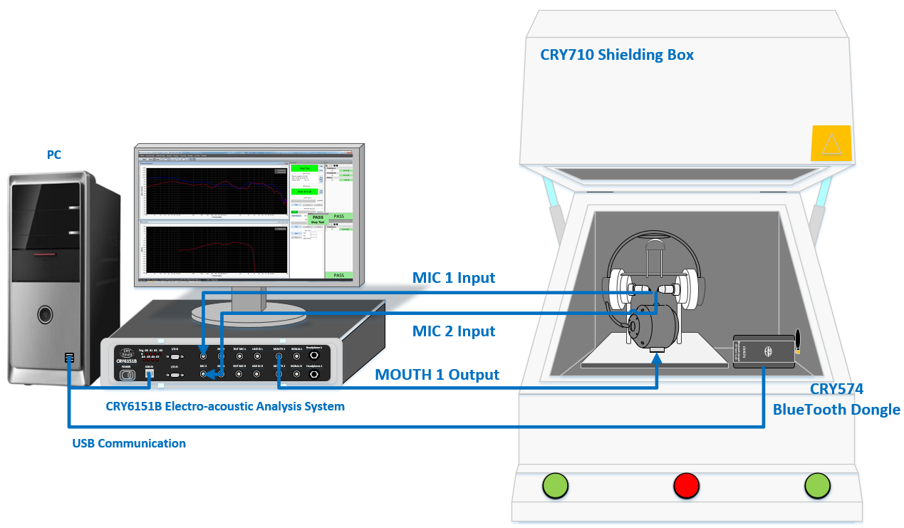
OQC
Bluetooth Headphone Test
Headphone SPK Typical Test Item
Frequency Response
THD
Typical Test Range: 20Hz-20kHz
Rub&Buzz
Phase
Balance
Headphone MIC Typical Test Item
Frequency Response
Typical Test Range: 100Hz-10kHz
SNR
THD
Equipment List
CRY6151B Electro-acoustic Analyzer
CRY609 Mouth Simulator
CRY710 Shielding Box
CRY574Pro Bluetooth Dongle
Headphone
CRY801 Headset Fixture
CRY318 Ear Simulator
CRY372 Measurement Microphone for Pressure Field
CRY506 ICP Preamplifier
Earbud
CRY711 Ear Simulator
CRY508 ICP Preamplifier
Test Access
CRY574Pro Bluetooth Dongle connects Bluetooth headphone
CRY574Pro Bluetooth Dongle outputs audio to Bluetooth headphone SPK -> Audio acquisition through measurement microphone -> Input into CRY6151B to analyze
CRY6151B outputs audio to headphone -> Audio acquisition through Bluetooth headphone MIC -> CRY574Pro Bluetooth Dongle receives audio -> Input into CRY6151B to analyze

Slide 8
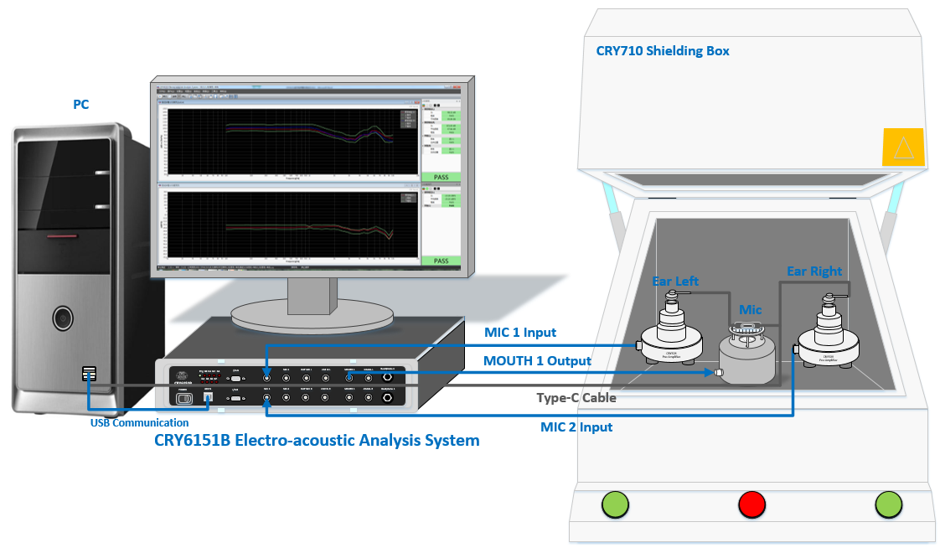
OQC
Type-C Headphone Test
Headphone SPK Typical Test Item
Frequency Response
THD
Typical Test Range: 20Hz-20kHz
Rub&Buzz
Phase
Balance
Headphone MIC Typical Test Item
Frequency Response
Typical Test Range: 100Hz-10kHz
SNR
THD
Equipment List
CRY6151B Electro-acoustic Analyzer
CRY609 Mouth Simulator
CRY710 Shielding Box
Headphone
CRY801 Headset Fixture
CRY318 Ear Simulator
CRY372 Measurement Microphone for Pressure Field
CRY506 ICP Preamplifier
Earbud
CRY711 Ear Simulator
CRY508 ICP Preamplifier
Test Access
Connect Type-C headphone to PC
CRY6151B outputs audio to Type-C headphone SPK -> Audio acquisition through measurement microphone -> Input into CRY6151B to analyze
CRY6151B outputs audio to CRY609 mouth simulator -> Audio acquisition through Type-C headphone MIC -> Input into CRY6151B to analyze

Slide 9
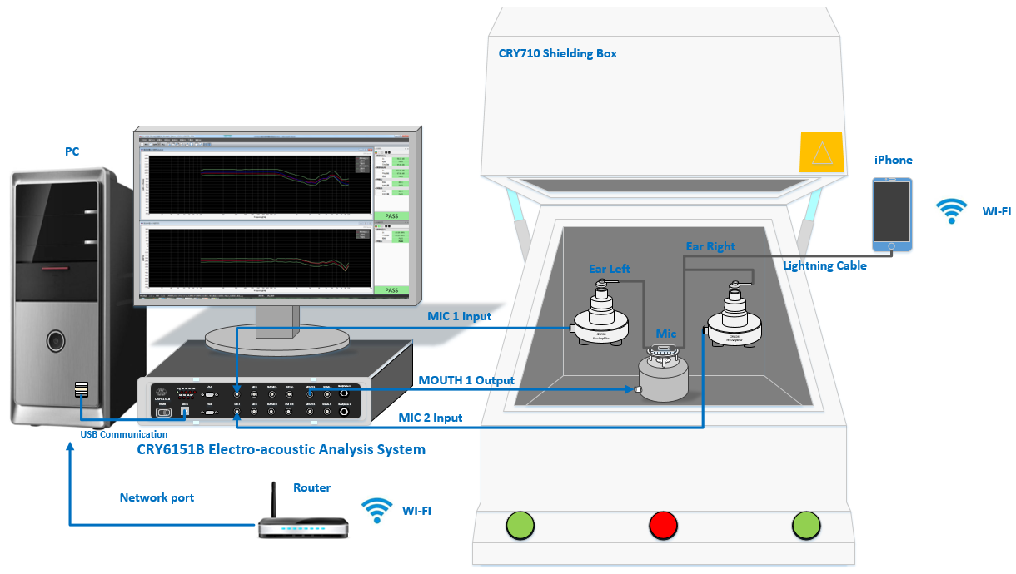
OQC
Lightning Headphone Test
Headphone SPK Typical Test Item
Frequency Response
THD
Polarity
Typical Test Range: 20Hz-20kHz
Rub&Buzz
Phase
Balance
Headphone MIC Typical Test Item
Frequency Response
Typical Test Range: 100Hz-10kHz
SNR
THD
Equipment List
CRY6151B Electro-acoustic Analyzer
CRY609 Mouth Simulator
CRY710 Shielding Box
iPhone
Headphone
CRY801 Headset Fixture
CRY318 Ear Simulator
CRY372 Measurement Microphone for Pressure Field
CRY506 ICP Preamplifier
Earbud
CRY711 Ear Simulator
CRY508 ICP Preamplifier
Test Access
CRY6151B outputs audio to iPhone app through WI-FI -> iPhone app outputs audio to lightning headphone -> Audio acquisition through measurement microphone -> Input into CRY6151B to analyze
CRY6151B outputs audio to CRY609 mouth simulator -> Audio acquisition through Lightning headphone MIC -> iPhone app outputs audio to PC through WI-FI -> Input into CRY6151B to analyze

Slide 10
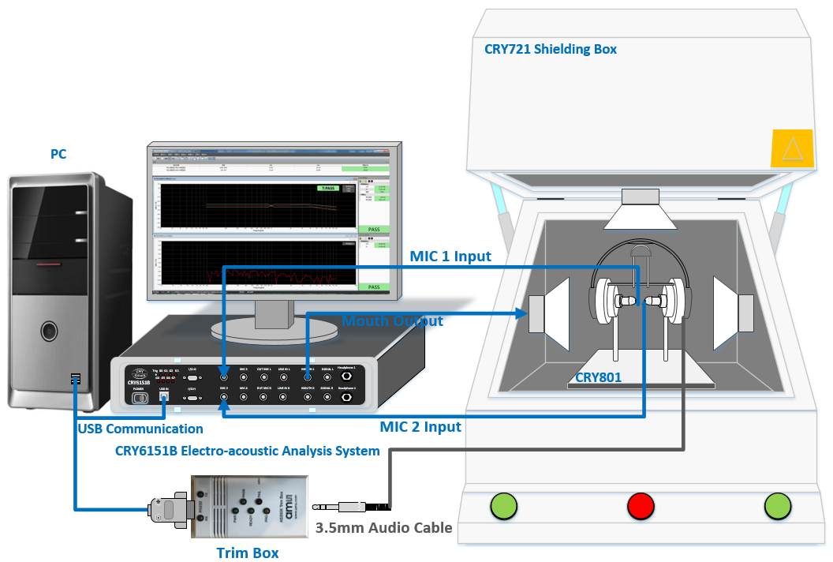
ANC Auto Calibration
Typical Test Item
ANC MIC Auto Calibration
ANC Performance
Passive Attenuation Performance
Typical Test Range: 20Hz-10kHz
Equipment List
CRY6151B Electro-acoustic Analyzer
Trim Box
Headphone
CRY801 Headset Fixture
CRY318 Ear Simulator
CRY372 Measurement Microphone for Pressure Field
CRY506 ICP Preamplifier
CRY721 Shielding Box
Earbud
CRY711 Ear Simulator
CRY508 ICP Preamplifier
CRY720 Shielding Box
Test Access
ANC off -> CRY6151B outputs noise to shielding box loudspeakers -> Audio acquisition through measurement microphone -> Input into CRY6151B to calculate passive attenuation curve
CRY6151B trims ANC MIC gain automatically -> CRY6151B outputs noise to shielding box loudspeakers -> Audio acquisition through measurement microphone -> Input into CRY6151B to calculate the ANC curve
The ANC curve reduces the PA curve to calculate the ANC performance under different gain

Slide 11
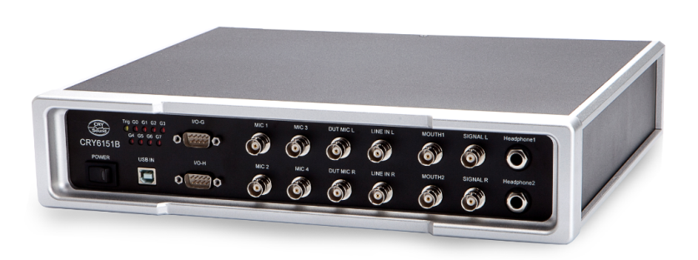
Product Specification
CRY6151B Electro-acoustic Analyzer
8 inputs, 4 outputs, High performance hardware with sound card, power amplifier, and microphone supply integrated
Test FR, SPL, THD, Impedance, F0, Phase, Balance, Polarity within a single frequency-sweep
CRY6151B Electro-acoustic Analyzer Parameters
Sample Rate | 44.1k~192k, 24 bits | Dynamic Range | Typical 115dB
background noise | -115dBV(1.8μV), 20~22k, A weighting | THD @1kHz | 0.001%
Frequency Response | 20~20kHz(±0.1dB)
Front Panel Interface Parameters
4 Inputs for Measurement Microphone | ICP supply voltage +24VDC | 2 Inputs for ECM Microphone | Supply voltage: 0~6.25V
2 Outputs for Mouth Simulator | Output power: 20W |  | Input impedance: 0 ~ 10kohm
 | Output impedance: 1，33，150，600，750ohm | 2 Inputs for Line In
2 Outputs for Headphone | Output power: 1W | 2 Outputs for electrical signal
 | Output impedance: 1，33，150，600，750ohm

Slide 12
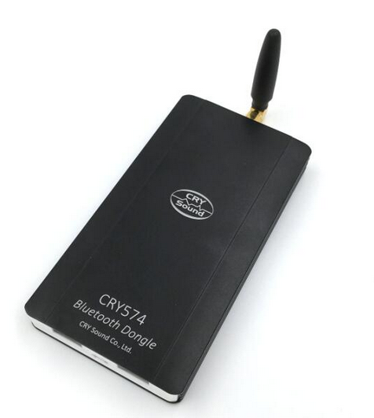
Product Specification
CRY574Pro Bluetooth Dongle
Connection speed up to 5 seconds
Support Wide Band Speech
Support getting device name, MAC address, volume, power, RSSI
Efficient button test
CRY574Pro Bluetooth Dongle Parameters
Core Specification | Bluetooth 3.0 | Interface | Micro USB
Profile and Roles | A2DP Source | Codec | SBC
 | HFP Audio Gateway |  | mSBC
 | AVRCP Target |  | CVSD
Antenna | U.FL |  | apt-X(extensible)
Dimension | 125mm x 66mm x 16mm(Without antenna)

Slide 13
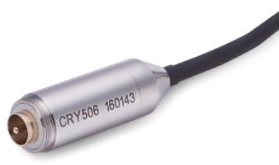
Product Specification
CRY506 ICP Preamplifier
CRY506 ICP preamplifier is powered by constant current supply.
High input impedance, low output impedance, lower noise, wide frequency response range, etc.
CRY506 ICP Preamplifier Parameters
Frequency Response | 20Hz ~ 50kHz(±0.2dB) | Noise(A Weighting) | ＜3μVrms
 | 10Hz ~ 100kHz(±0.5dB) | Noise(Z Weighting) | ＜10μVrms
Input Impedance | ＞10GΩ/0.5pF | Gain | -0.3dB
Output Impedance | ＜20Ω | Interface | BNC
THD | ＜0.1% | Temperature | -30℃ to +70℃
MAX Output Voltage | ＞5.0 Vrms (+24V Supply) | Thread | M11.7 x 0.423mm
Power Supply | ICP (2mA ~ 10mA) | Diameter | 12.7mm (1/2 inch)
Typical Operating Current | 4mA | Length | 38mm

Slide 14
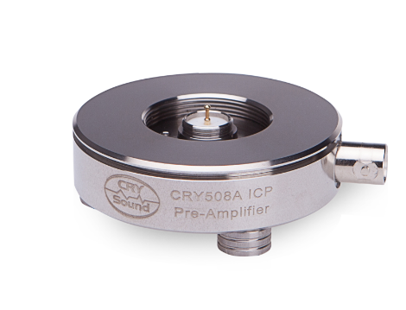
Product Specification
CRY508 ICP Preamplifier
CRY506 ICP preamplifier is powered by constant current supply.
High input impedance, low output impedance, lower noise, wide frequency response range, etc.
CRY508 ICP Preamplifier Parameters
Frequency Response | 20Hz ~ 50kHz(±0.2dB) | Noise(A Weighting) | ＜3μVrms
 | 10Hz ~ 100kHz(±0.5dB) | Noise(Z Weighting) | ＜10μVrms
Input Impedance | ＞2GΩ/0.5pF | Gain | -0.3dB
Output Impedance | ＜20Ω | Interface | BNC
THD | ＜0.1% | Temperature | -30℃ to +70℃
MAX Output Voltage | ＞5.0 Vrms (+24V Supply) | Thread | M11.7 x 0.423mm
Power Supply | ICP (2mA ~ 10mA) | Diameter | 61mm
Typical Operating Current | 4mA | Length | 25mm

Slide 15
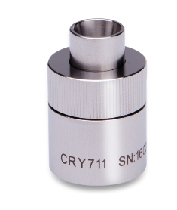
Product Specification
CRY711 Ear Simulator
Simulate earplugs catheter inserted into the ear canal or the auricle way
Built-in CRY372 measurement microphone for pressure field
Commonly used in acoustic test for high-quality in-ear headphones
CRY711 Ear Simulator Parameters
Comply Standard | ITU-T P.57 sec.5.2 Type 2 suggestions and IEC60318-4
Frequency Range | 100Hz ~ 10kHz ± 1dB(artificial ear impedance)
Coupled cavity frequency range | 20Hz ~ 16kHz(coupled cavity using)
Height | 23mm(including connection adapter)
Diameter | 23.77mm
Weight | 45g(without microphone)

Slide 16
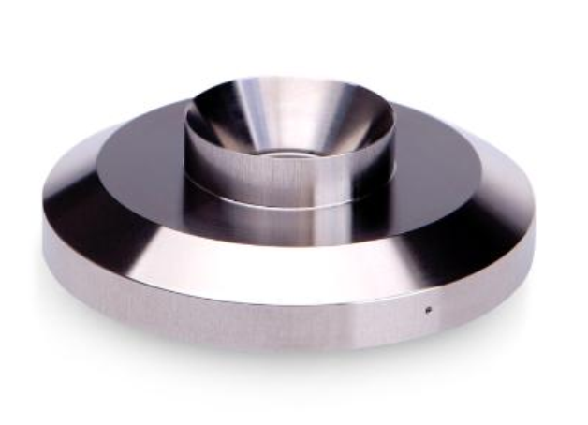
Product Specification
CRY318 Ear Simulator
Simulate human ear and loads a sound source the same way as human ear
Co-use with CRY372 measurement microphone for pressure field
Commonly used in acoustic test for telephone receiver and handsets
CRY318 Ear Simulator Parameters
Comply Standard | ITU-T P.57 sec.5.1 Type 1suggestions and IEC60318-1
Frequency Range | 100Hz ~ 4kHz ± 1dB(artificial ear impedance)
Coupled cavity frequency range | 20Hz ~ 16kHz(coupled cavity using)
Height | 32mm(including connection adapter)
Diameter | 60mm
Weight | 208g (including connection adapter)

Slide 17
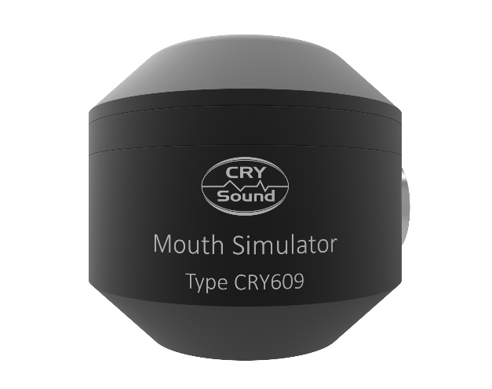
Product Specification
CRY609 Mouth Simulator
Acoustic measurement standard sound source
THD on 200Hz ～ 10kHz reaches leading level in the world
Complies with standards IEEE 269,661 and ITU-T P51 suggestions “mouth reference point” requirement
CRY609 Mouth Simulator Parameters
Min Continuous Output SPL | 200Hz~10kHz: 110dB(25mmMRP) | Mouth Open Diameter | Ø20mm
 | 100Hz~10kHz: 100dB(25mmMRP) | Lip Ring | Diameter: Ø45mm
THD | 200Hz~10kHz: ＜0.5%， Max 0.8%(94dBSPL, 25mmMRP) |  | Height: 25mm
 |  | Diameter | Ø104mm
Frequency Response | 94dB±1dB(100Hz~10kHz) after compensation | Height | 94mm
Impedance | 4ohm | Weight | 1.32kg
Continuous Max power | 20W | Interface | BNC
Instantaneous Max Power | 100W(1s)

Slide 18
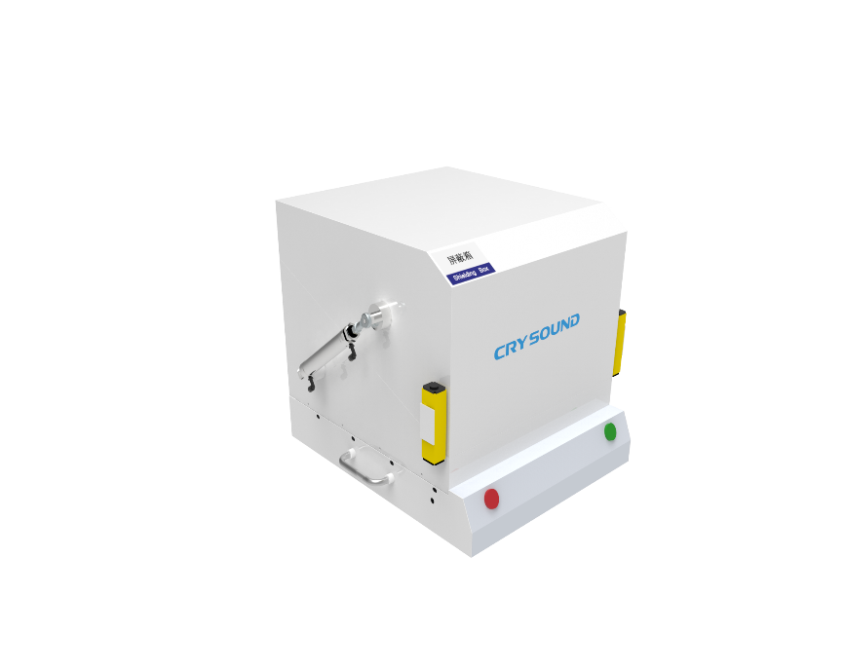
Product Specification
CRY710 Shielding Box
Dedicated to acoustic performance measurement of Bluetooth headset and microphone
Provide RF shielding for Bluetooth, WI-FI test, avoiding interference among production lines; Provide sound insulation environment for acoustic test
Pneumatic open and close through serial port control
CRY710 Shielding Box Parameters
Frequency Range | 0.8GHz~3GHz | Working Dimension | (L)300x(W)300x(H)280mm±5mm
Shielding Effect | 0.8GHz~3GHz≥60dB | Box Dimension | (L)430x(W)390x(H)340mm±5mm
Soundproofing Effect | Outdoor noise: 80dB | External Dimension | (L)550x(W)490x(H)420mm±5mm
 | Indoor noise: ≤40dB | Net Weight | 26.3KG ± 0.1KG
Material | Sheet metal + RF shielding and sound insulation material | Appearance Color | Creamy White

Slide 19
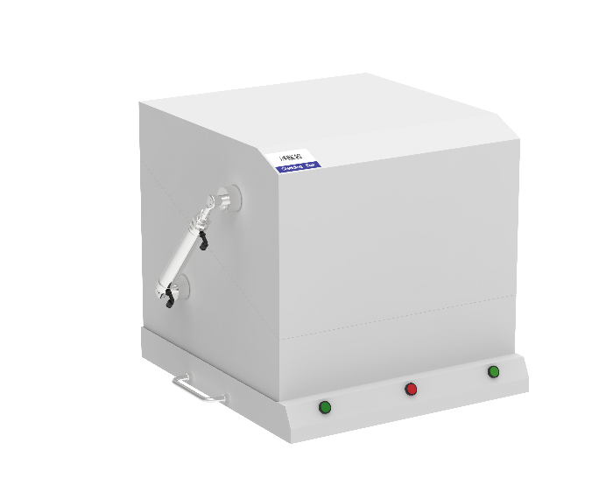
Product Specification
CRY720 Shielding Box(One Loudspeaker)
Provide ANC test environment, reducing noise exposure to work environment
Provide RF shielding for Bluetooth, WI-FI test, avoiding interference among production lines; Provide sound insulation environment for acoustic test
Pneumatic open and close through serial port control
CRY720 Shielding Box Parameters
Frequency Range | 0.8GHz~3GHz | Working Dimension | (L)300x(W)300x(H)310mm±5mm
Shielding Effect | 0.8GHz~3GHz≥60dB | Box Dimension | (L)470x(W)460x(H)420mm±5mm
Soundproofing Effect | Outdoor noise: 80dB | External Dimension | (L)560x(W)540x(H)510mm±5mm
 | Indoor noise: ≤40dB | Net Weight | 37.5KG ± 0.1KG
Material | Sheet metal + RF shielding and sound insulation material | Appearance Color | Beige
Built-in Loudspeaker Parameters
Type | JBL BM8008 | SPL | 100dB
Output Impedance | 6ohm | Power | 120W
Frequency Range | 94dB±10dB(100Hz~10kHz)

Slide 20
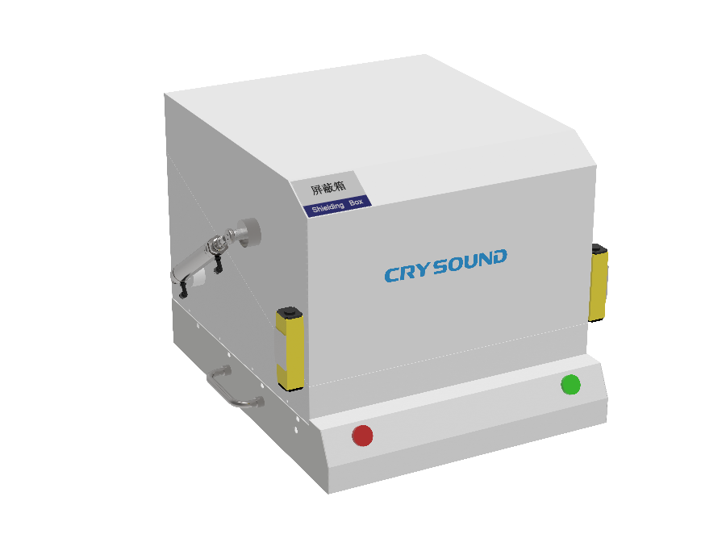
Product Specification
CRY721 Shielding Box(Three Loudspeakers)
Provide ANC test environment, reducing noise exposure to work environment
Provide RF shielding for Bluetooth, WI-FI test, avoiding interference among production lines; Provide sound insulation environment for acoustic test
Pneumatic open and close through serial port control
CRY721 Shielding Box Parameters
Frequency Range | 0.8GHz~3GHz | Working Dimension | (L)400x(W)600x(H)420mm±5mm
Shielding Effect | 0.8GHz~3GHz≥60dB | Box Dimension | (L)550x(W)760x(H)550mm±5mm
Soundproofing Effect | Outdoor noise: 80dB | External Dimension | (L)660x(W)880x(H)630mm±5mm
 | Indoor noise: ≤40dB | Net Weight | 73.3KG ± 0.1KG
Material | Sheet metal + RF shielding and sound insulation material | Appearance Color | Creamy White
Built-in Loudspeaker Parameters
Type | JBL BM8008 | SPL | 100dB
Output Impedance | 6ohm | Power | 120W
Frequency Range | 94dB±10dB(100Hz~10kHz)

Slide 21
Thanks For
Watching!
杭州兆华电子有限公司
杭州市余杭区闲林工业园闲兴路31-1号
Tel : 0571—88225198
E-mail : cry@crysound.com
www.crysound.com

